Slide 1
David Attenborough
Poster Competition 2025

Slide 2
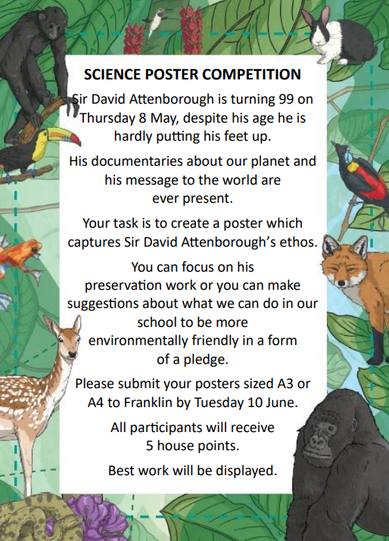
Thank you everyone who took part in this year’s poster competition
Please give yourself 5 house points

Slide 3
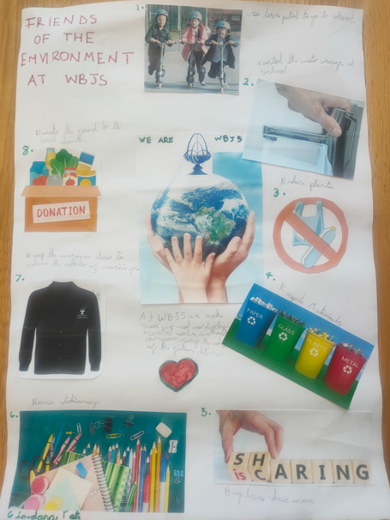
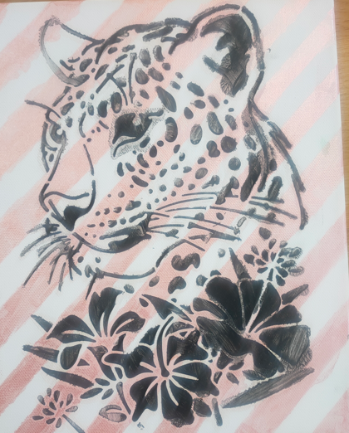
Winners in Lower School
Giordana in Tate class
Madeleine in Darwin class

Slide 4
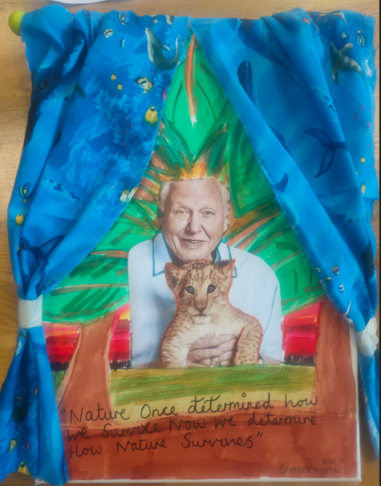
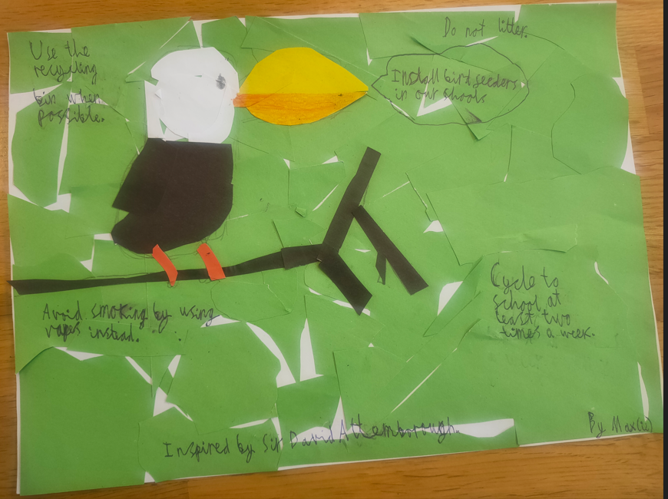
Winners in Upper School
Sameera in Franklin class
Maxie in Curie class

