Slide 1

Problem of the Week!

Slide 2
Our Autumn Leaderboard:
Year 3 Leaderboard
Year 4 Leaderboard
Year 5 Leaderboard
Year 6 Leaderboard
 | Name | Points
1 | Grant M | 84
2 | Charlie H | 55
3 | Oscar H | 55
4 | David | 37
5 | Mavis | 33
6 | Hansel | 30
7 | Andrii K | 18
8 | George R | 10
9 | Max | 6
10 | Josh W | 5
11 | Josh T | 5
12 | Willow L | 1
13
14
15
16
17
18
19
20
 | Name | Points
1 | Aaron D | 93
2 | Rose C J | 89
3 | Luca C | 89
4 | Olivia H | 89
5 | Nahla G | 83
6 | James R | 80
7 | Harry A | 78
8 | Gus | 74
9 | Jay S | 65
10 | Jackson L | 58
11 | Alifiya H | 21
12 | Keon B | 13
13 | Evelyn T | 8
14 | Thomas | 5
15 | Teagan | 2
16
17
18
19
20
 | Name | Points
1 | Elijah A | 91
2 | Lyla - Elyss P | 88
3 | Vineeth P | 88
4 | Ben H | 81
5 | Otis T | 29
6 | Leo M | 21
7 | Anvi | 15
8 | Kai | 11
9 | Joseph O | 7
10 | Lily D | 7
11 | Lily W | 2
12 | Priya G | 1
13
14
15
16
17
18
19
20
 | Name | Points
1 | Aaron G | 91
2 | Bella S | 88
3 | Matilda G | 79
4 | Myren P | 15
5 | Lily M | 8
6
7
8
9
10
11
12
13
14
15
16
17
18
19
20

Slide 3
West Byfleet Junior School
Christmas Problems 1
There is a copy on the school website.
Return to Miss Lawrence by email (potw one) or in person by end of day TUESDAY.
4 Points
6 points
10 Points
Christmas Presents
Christmas Tree Challenge
Santa’s Surprise
Santa wants to give each of his six Elf helpers who work at his workshop 15 presents to thank them for all their hard work over Christmas.
How many presents will he need to buy? You must show your workings.
Four children of the Holly family are getting ready to open their presents from Santa. They are Alex, Harry, Charlie and Sam. They receive a book, train, teddy bear and building blocks.
Use the clues to find out who received which represent and in what order.
Clue 1- The child who opened their present first received a book.
Clue 2-The child who opened their present last received a train.
Clue 3-Alex opened his present straight after the child who received the teddy bear.
Clue 4-Sam opened his present immediately before Charlie.
Clue 5- The four children were: the recipient of the teddy bear; Alex; the person who opened the present first and Harry.
Mum and Dad have put all the presents for their two children under two trees. There are 16 presents and there is an odd number under each tree.
How many presents could be under each tree?
There are 8 possible answers. Can you find them all?
5 house points for every entry!

Slide 4
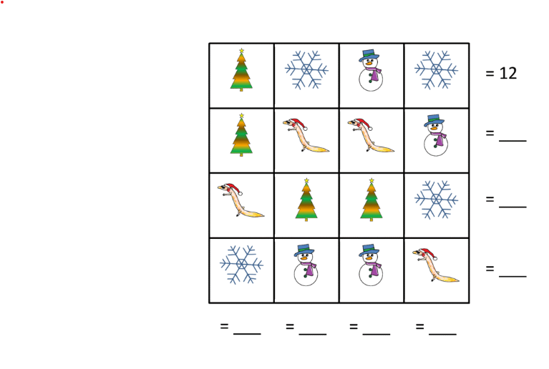
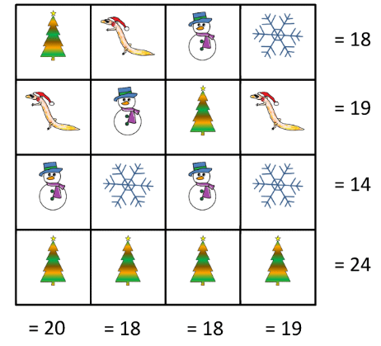
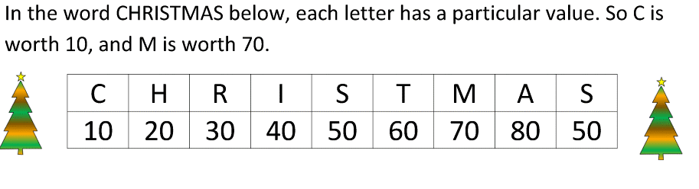
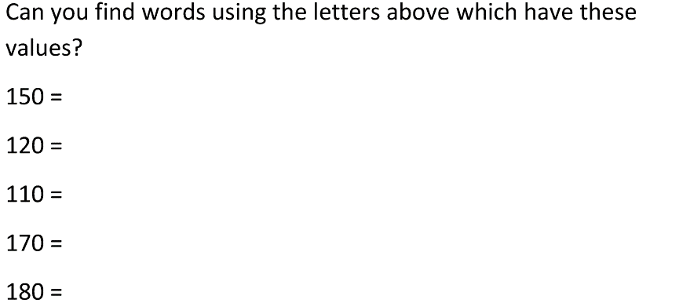
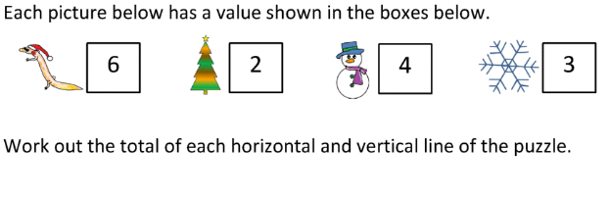
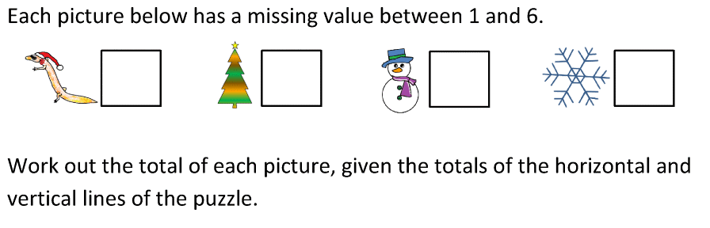
West Byfleet Junior School
Christmas Problems 2
There is a copy on the school website.
Return to Miss Lawrence by email (potw one) or in person by end of day WEDNESDAY 3RD January
4 Points
6 points
10 Points
Christmas Square 1 Challenge
Christmas Square 2 Challenge
Christmas Word Challenge
5 house points for every entry!

Slide 5


Slide 6
Year Group Accuracy
Year Group | Accuracy
Year 6 | 92.89%
Year 3 | 92.65 %
Year 5 | 90.26 %
Year 4 | 89.42%

Slide 7
Active Players
Year 3 | Active Players
Kew | 75%
Eden | 62%
Tate | 43%
Year 5 | Active Players
Franklin | 100%
Curie | 93%
Lonsdale | 90%
Year 4 | Active Players
Darwin | 83%
Nightingale | 69%
Shakespeare | 65%
Year 6 | Active Players
Snowdon | 72%
Aviemore | 67%
Windermere | 42%

Slide 8
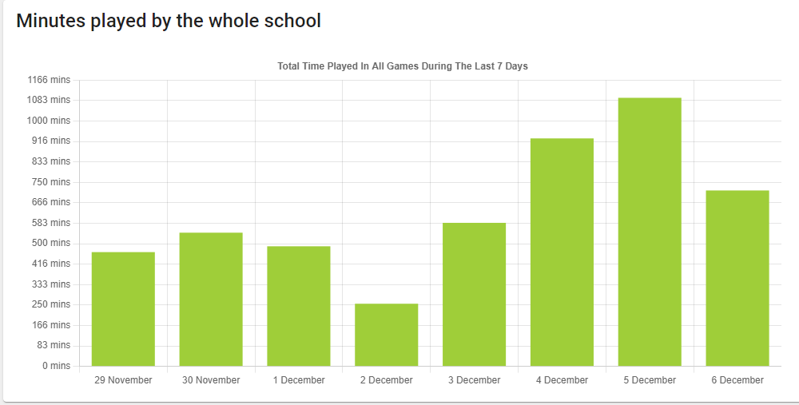
Whole School
Total Minutes

Slide 9
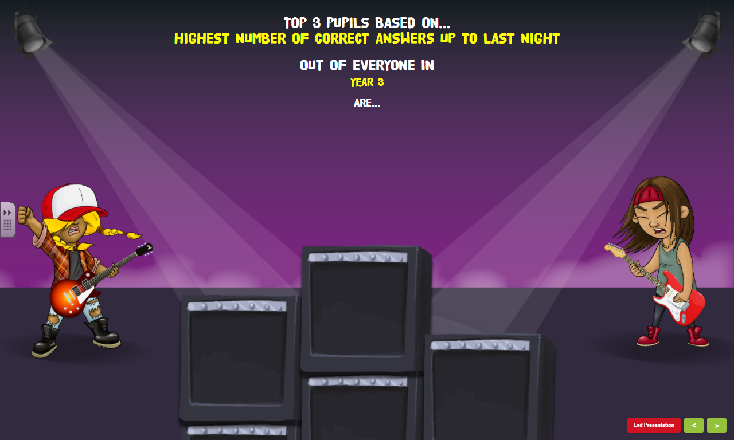
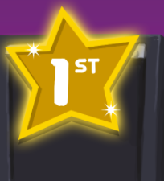
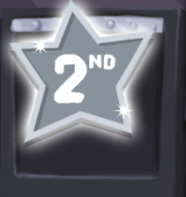
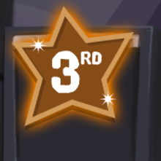
Top 3 pupils based on…
‘The most correct answers over the last 7 days’
out of everyone in
Year 3 are…
Andrii K
Chase L
Oliver B

Slide 10
Top 3 pupils based on…
‘Biggest improvement in accuracy over the last week’
out of everyone in
Year 3 are…
Rose O
Hansel
Charles H

Slide 11
Top 3 pupils based on…
‘The most correct answers over the last 7 days’
out of everyone in
Year 4 are…
Sebastian G
Gustav
Thomas A

Slide 12
Top 3 pupils based on…
‘Biggest improvement in accuracy over the last week’
out of everyone in
Year 4 are…
Evie T
Edward W
George S

Slide 13
Top 3 pupils based on…
‘The most correct answers over the last 7 days’
out of everyone in
Year 5 are…
Joseph
Marshall
Lyla-Elyss

Slide 14
Top 3 pupils based on…
‘Biggest improvement in accuracy over the last week’
out of everyone in
Year 5 are…
Ahmed
Marshall
Lara M

Slide 15
Top 3 pupils based on…
‘The most correct answers over the last 7 days’
out of everyone in
Year 6 are…
Joshua M
Matthew B
Matthew D

Slide 16
Top 3 pupils based on…
‘Biggest improvement in accuracy over the last week’
out of everyone in
Year 6 are…
Juan J
Maryam G
Archie P

Slide 17

Our Current Rock Heroes are…
James L
Adam K
Ahmed - Raza H
Kai S
Lyla- Elyss P
Matthew B
Leo C
Joseph O
Newbies
Congratulations to :
Peggy E; Harrison P and Rameen S
Well done – that means you can recall your times tables in under one second!
Who else can become a Rock Hero?

