Slide 1



Photography Competition
Autumn Term Competition Winners 2022
Notes:
1

Slide 2
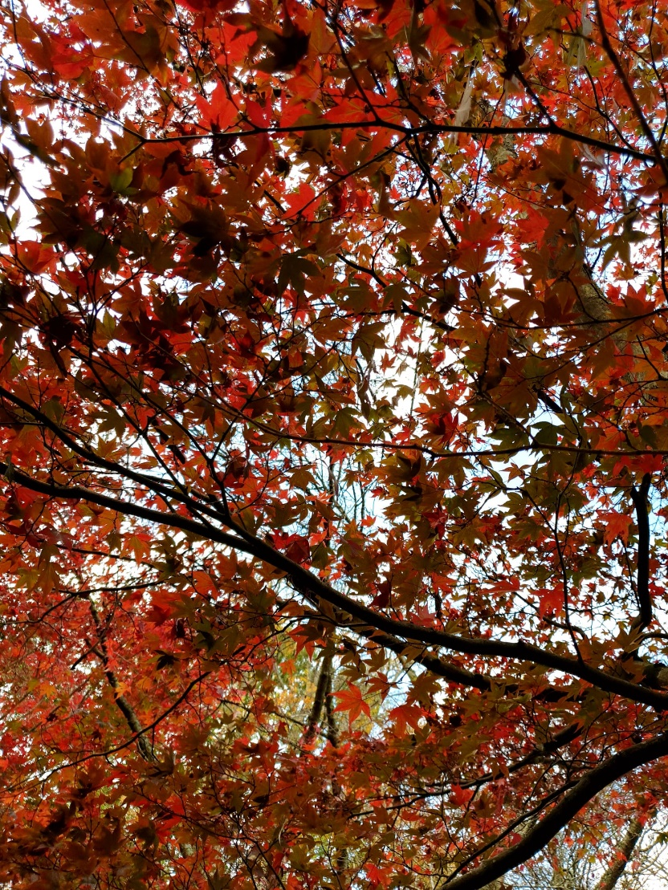
Aaron – Year 3

Slide 3
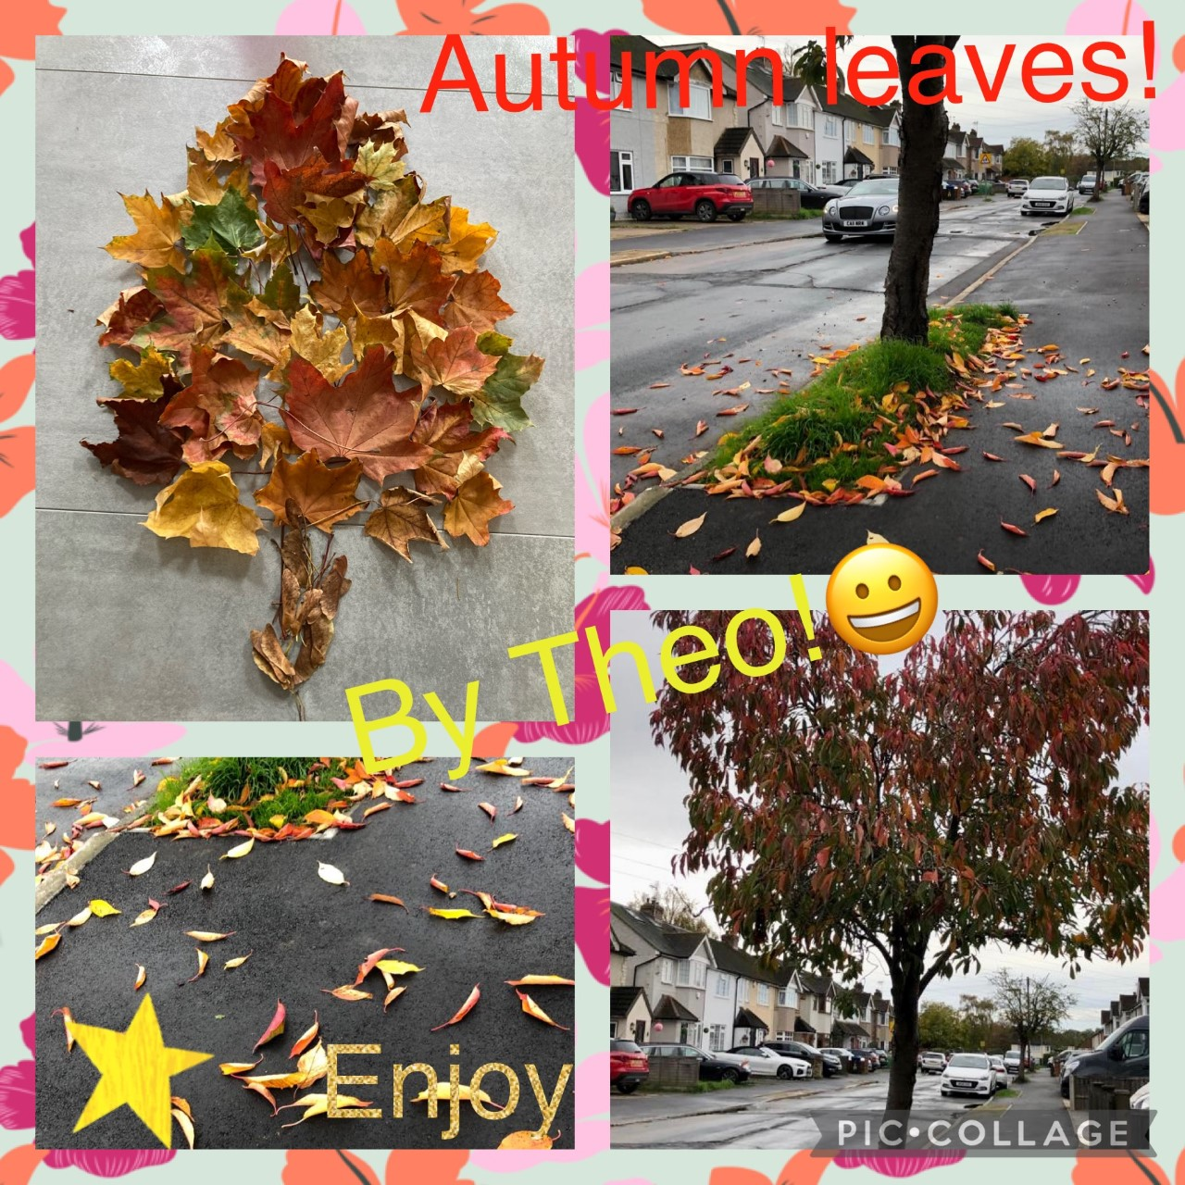
Theo – Year 3

Slide 4

Imogen – Year 5

Slide 5
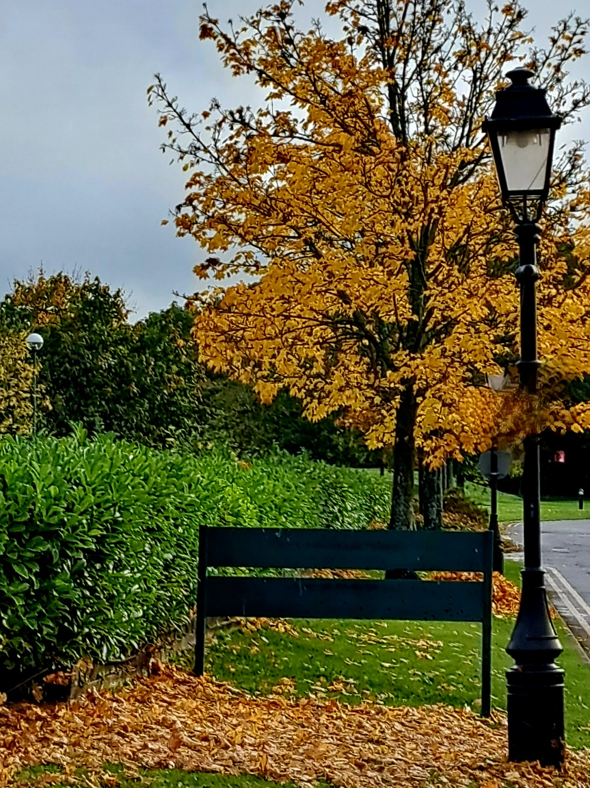
Jacob – Year 3

Slide 6
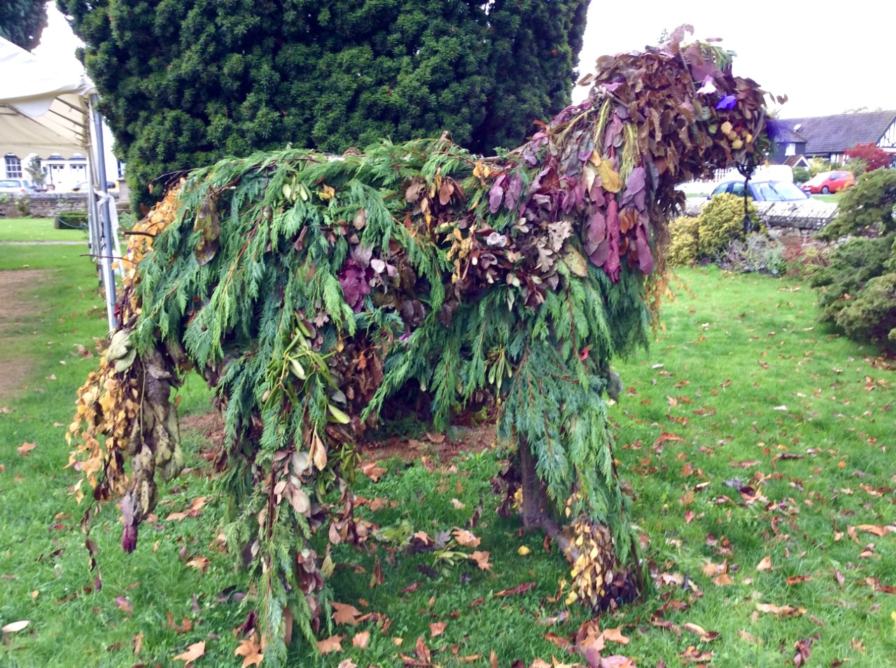
Lily – Year 4

Slide 7
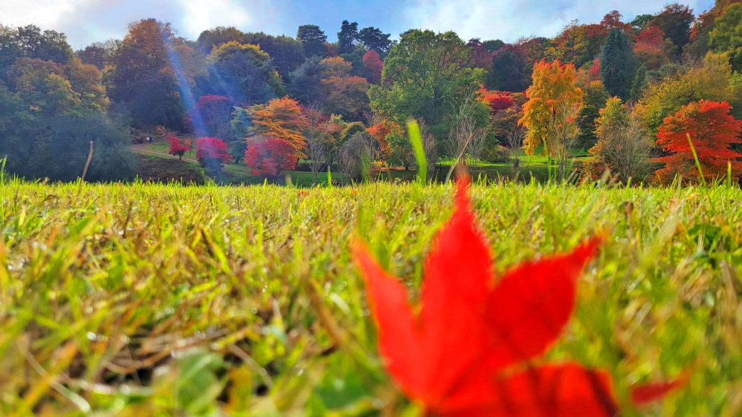
Helina – Year 4

Slide 8
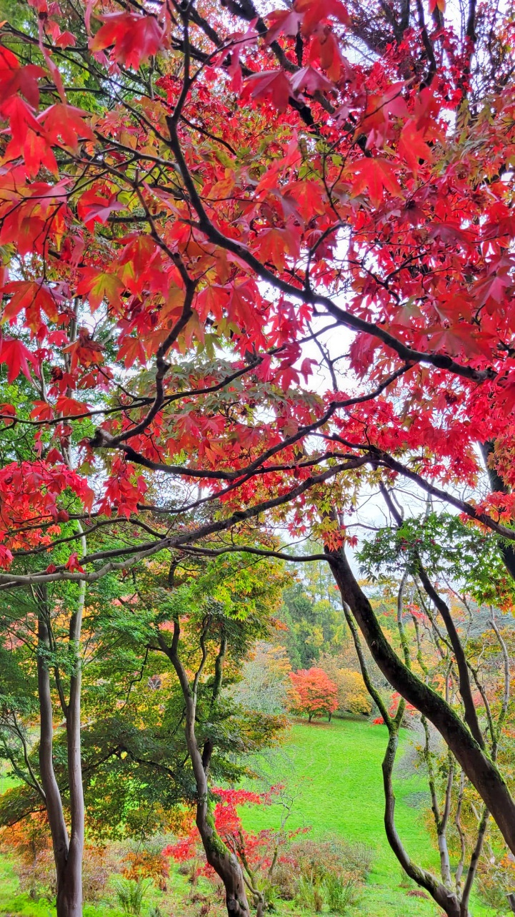
Helios – Year 5

Slide 9
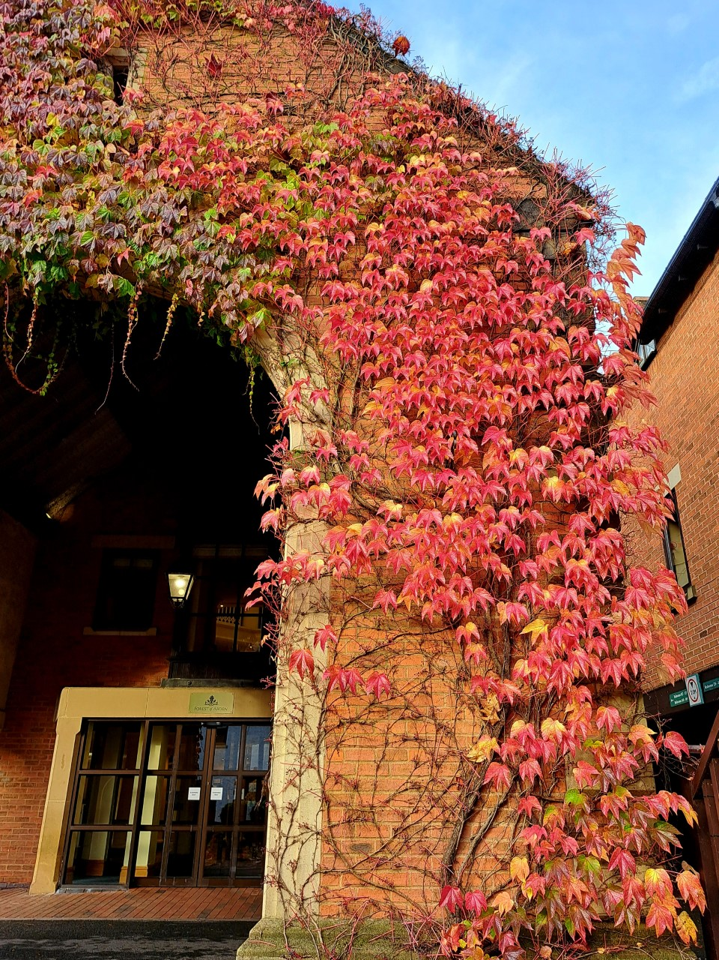
Sam – Year 3

